Slide 1
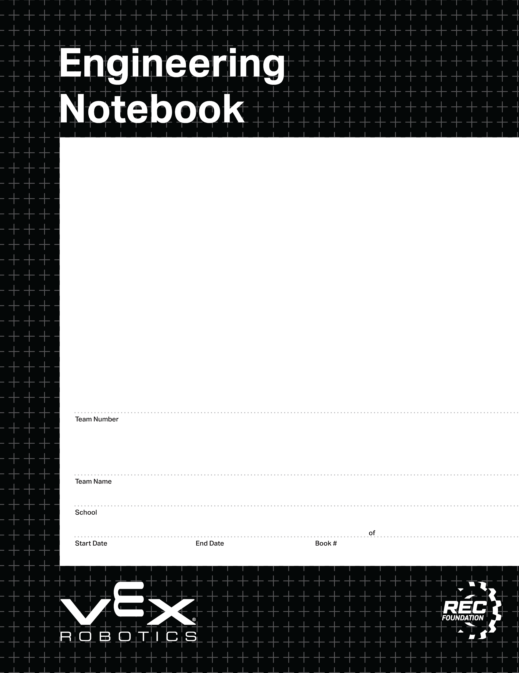
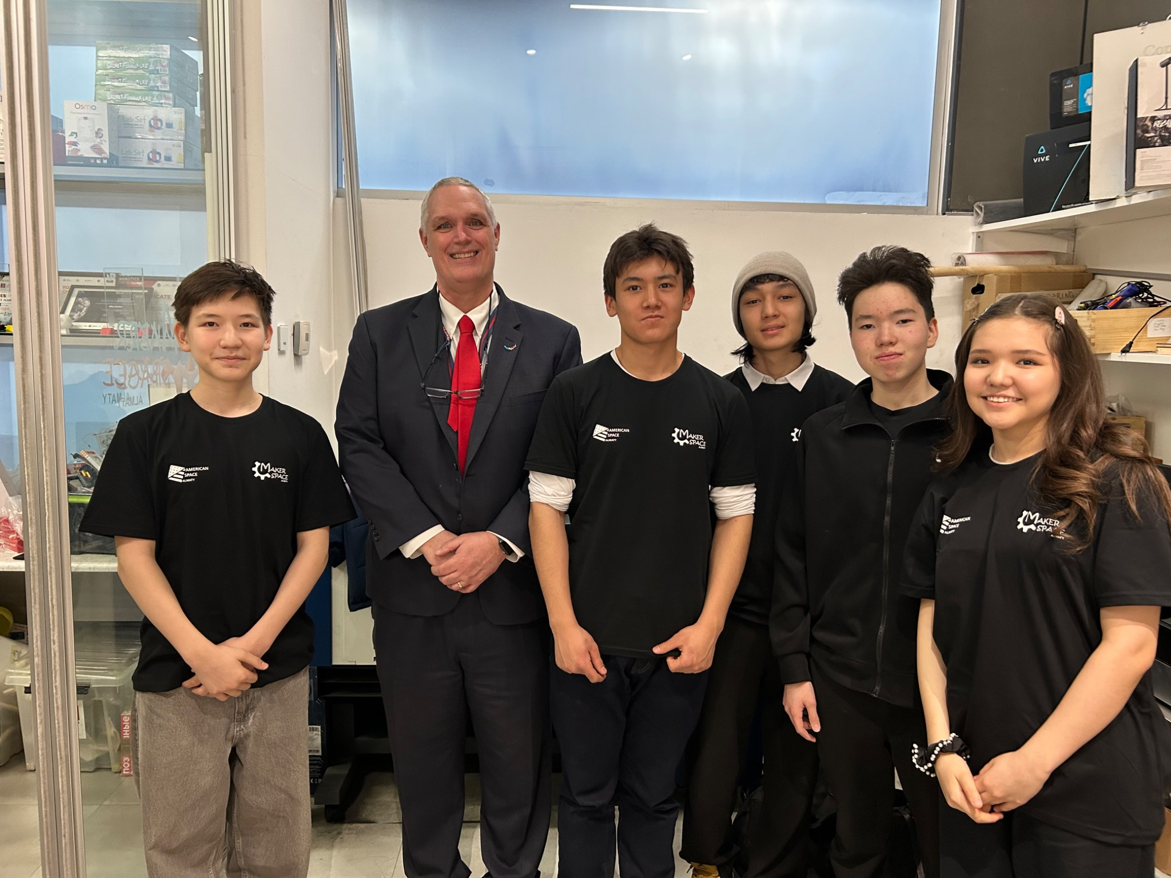
This is an alternate front page.
Place a team photo or other information here.
1737X
EngiNova
Makerspace Almaty
13.02.24
28.02.24
1
1
V3.1 Date 10.3.24

Slide 2
Changelog
Changelog
V3.1 Date 10.03.24
Updated field maps to match rule change
V3.0 Date 6.10.24
Added field maps for 2024-2025 “High Stakes” Game
Added updated calendar pages
V2.1 Date 6.12.23
Added new calendar and planner layouts starting on slide 21. These are not in the “layouts” dropdown, so if you delete one by mistake you will need to copy it from the template again. This keeps the layout options from getting too crowded.
Added more customizable front covers. There is an option with black text for lighter colors and an option with white text for darker colors.
Moved extra controller map and brain map assets to parts library document
Changed the divider page to be customizable.
V2.0 Date 5.15.23
Added new template pages for controller map & brain map
Updated field map to 2023-2024 “Over Under” Game
Added second title page template for additional customizability
You can delete this page from your Team’s notebook!
Christine
10/03/2024
01

Slide 3
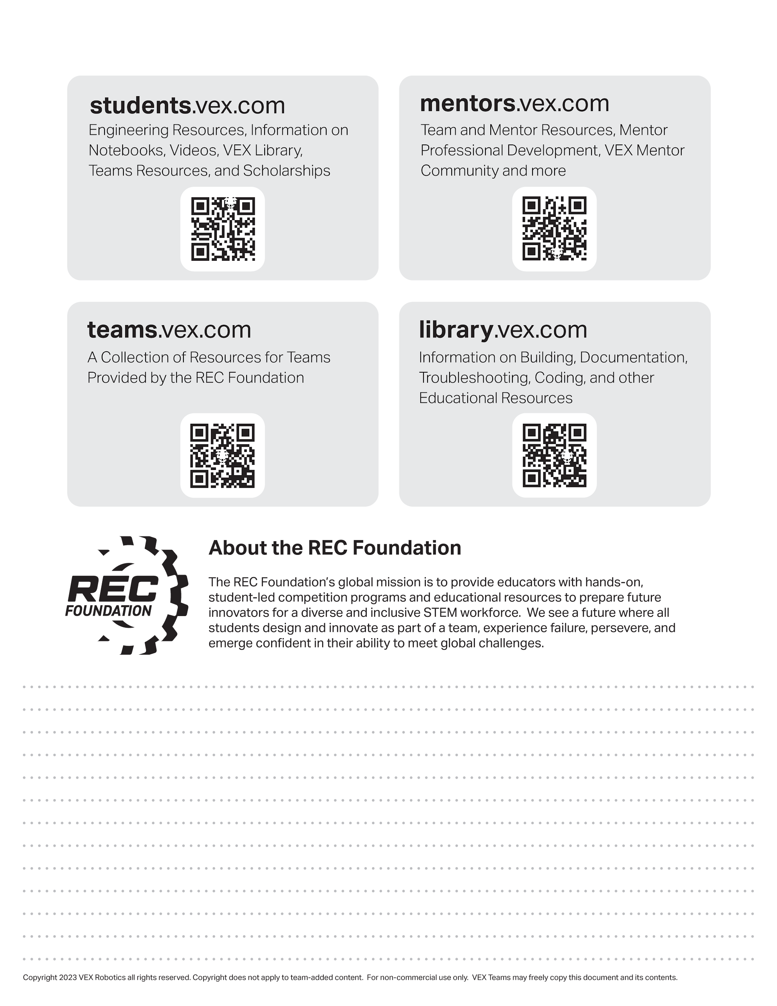
Resources
engineering.vex.com
notebooking.vex.com
coding.vex.com
Judging Rubric for Notebooks
vex.com
roboticseducation.org
V5RC 2024-2025 Game - Rules & Game Video
Send suggestions and comments about these Digital Notebooks and Digital Parts
to notebooks@vex.com

Slide 4
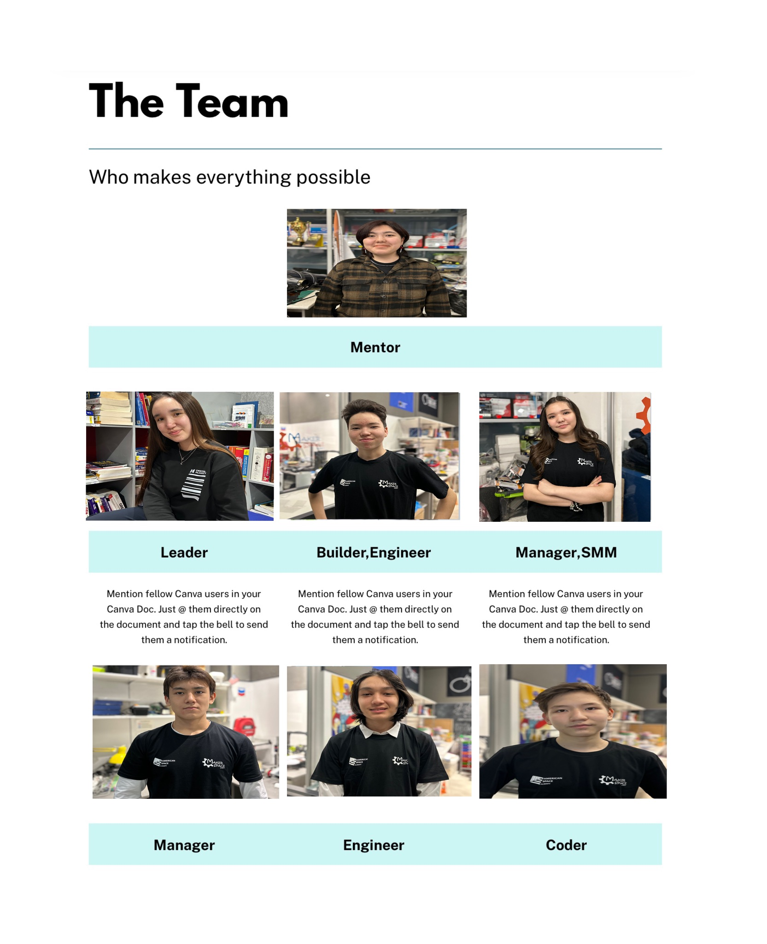
12345 Title Title Title Date Date Date

Slide 5
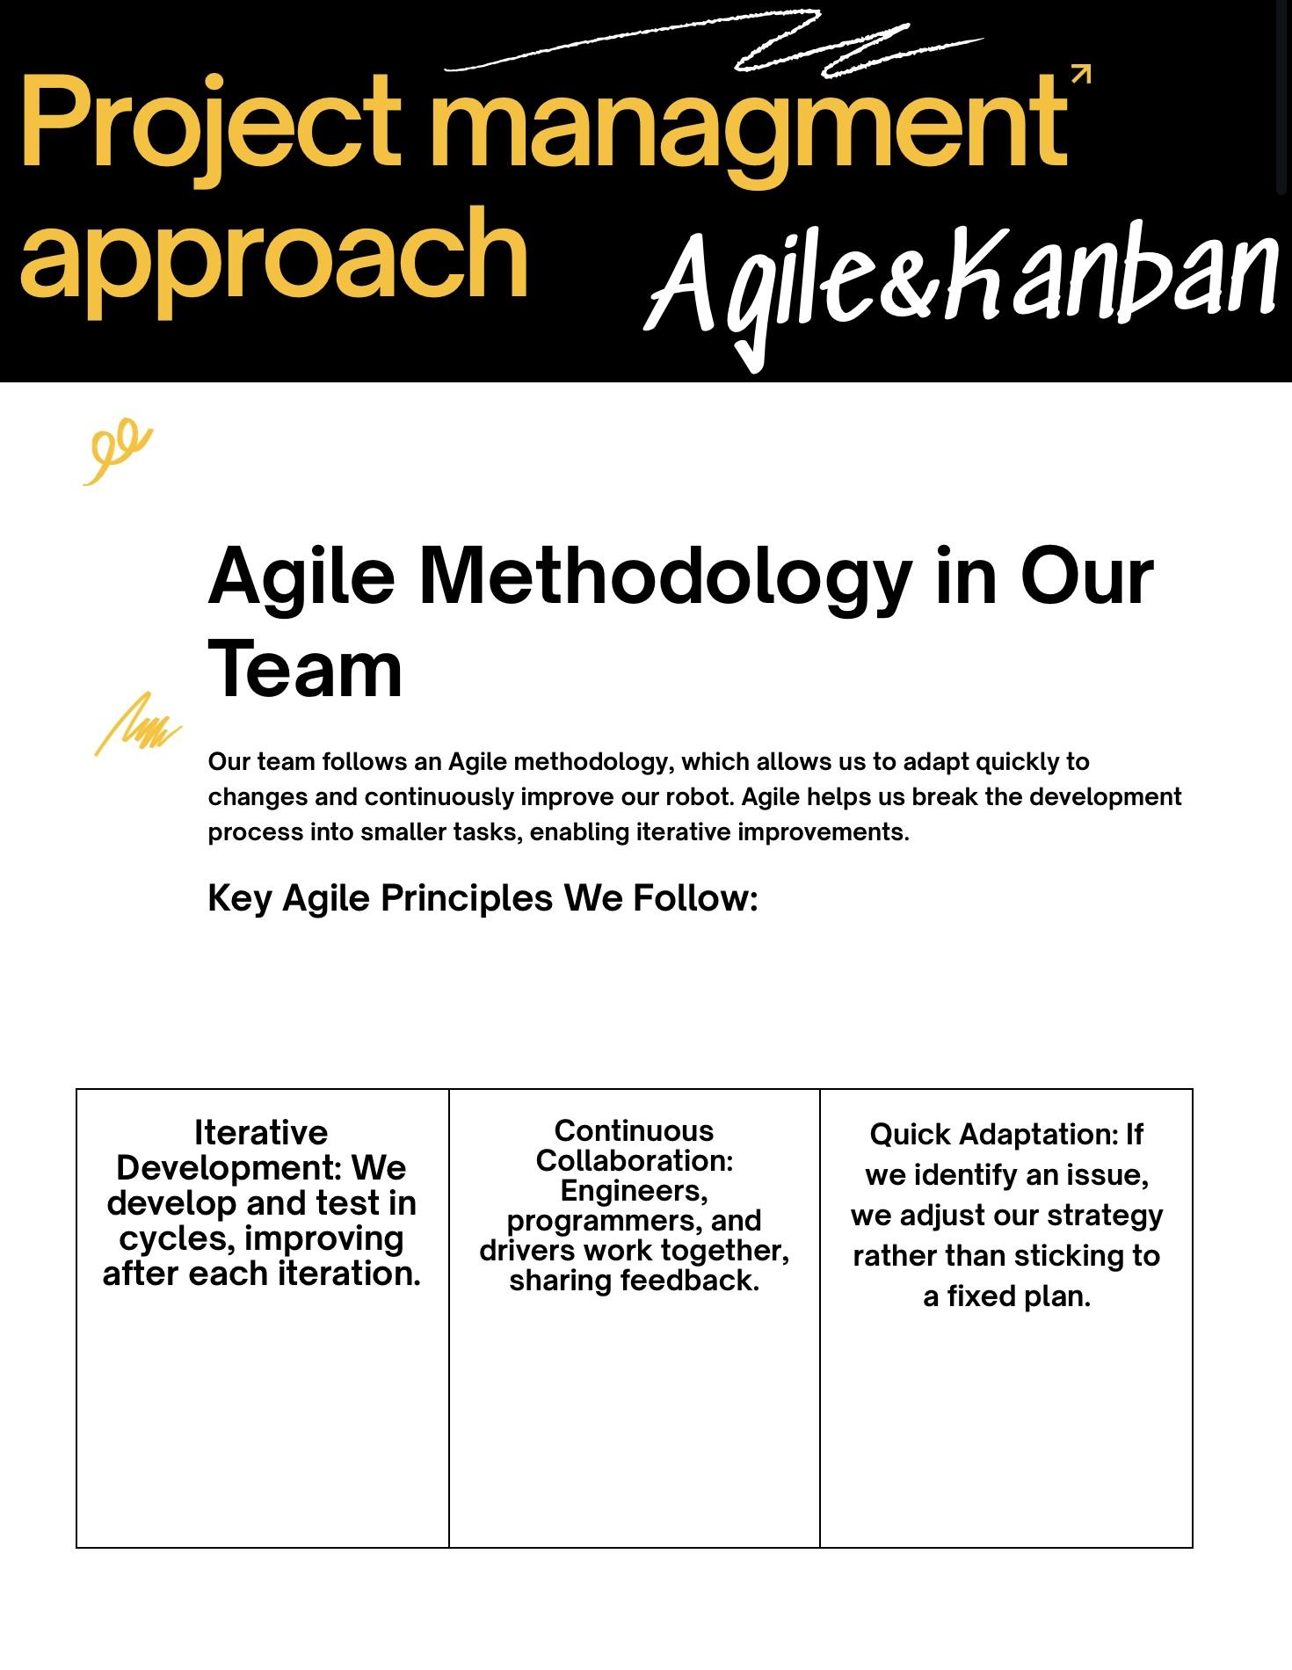

Slide 6
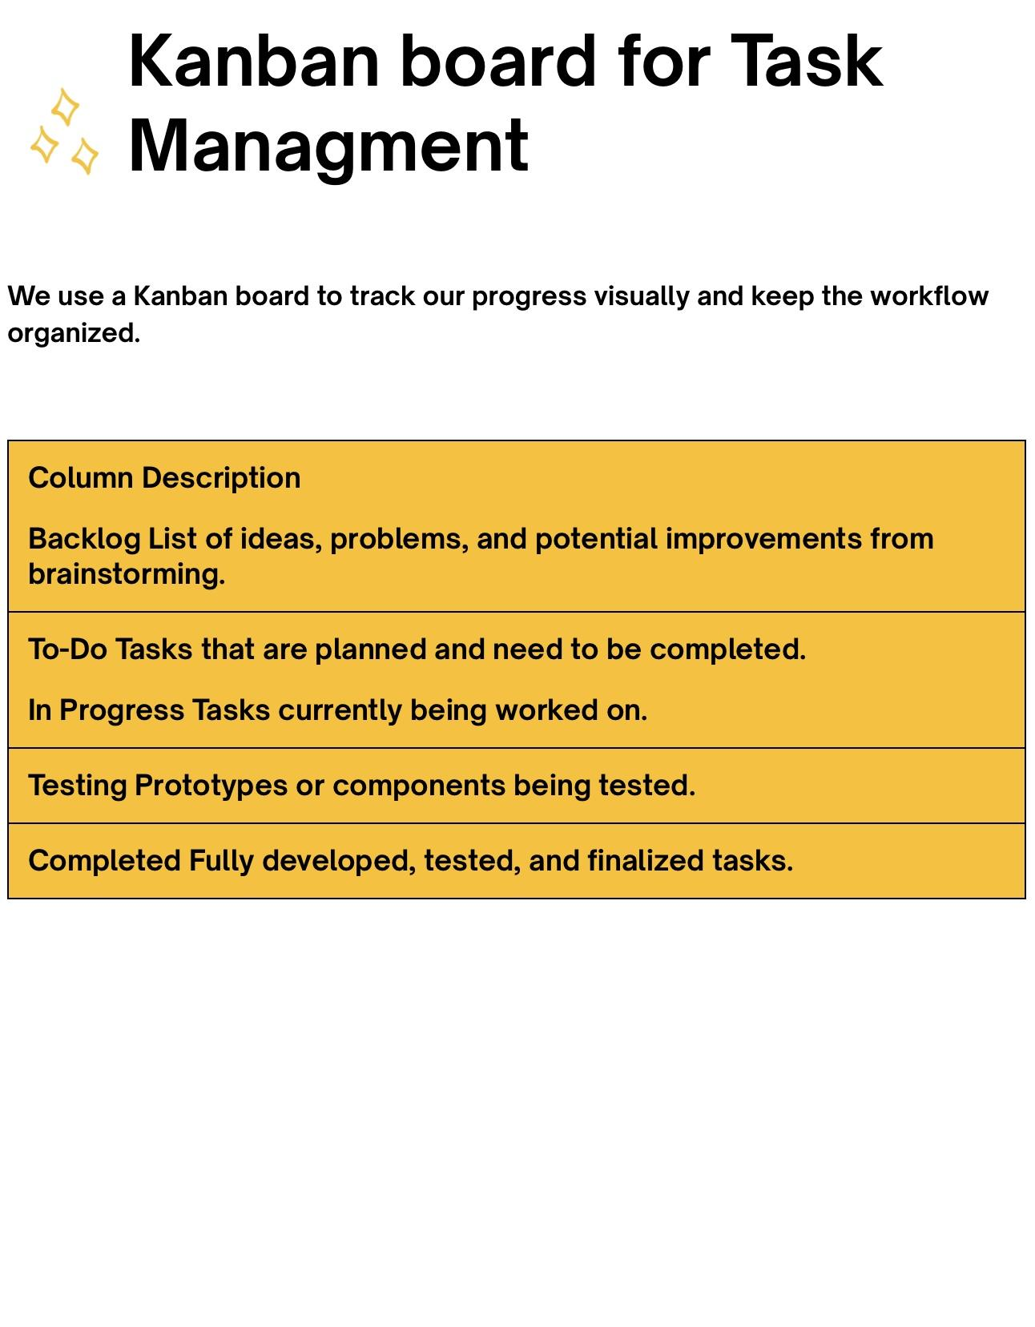

Slide 7
Section A

Slide 8
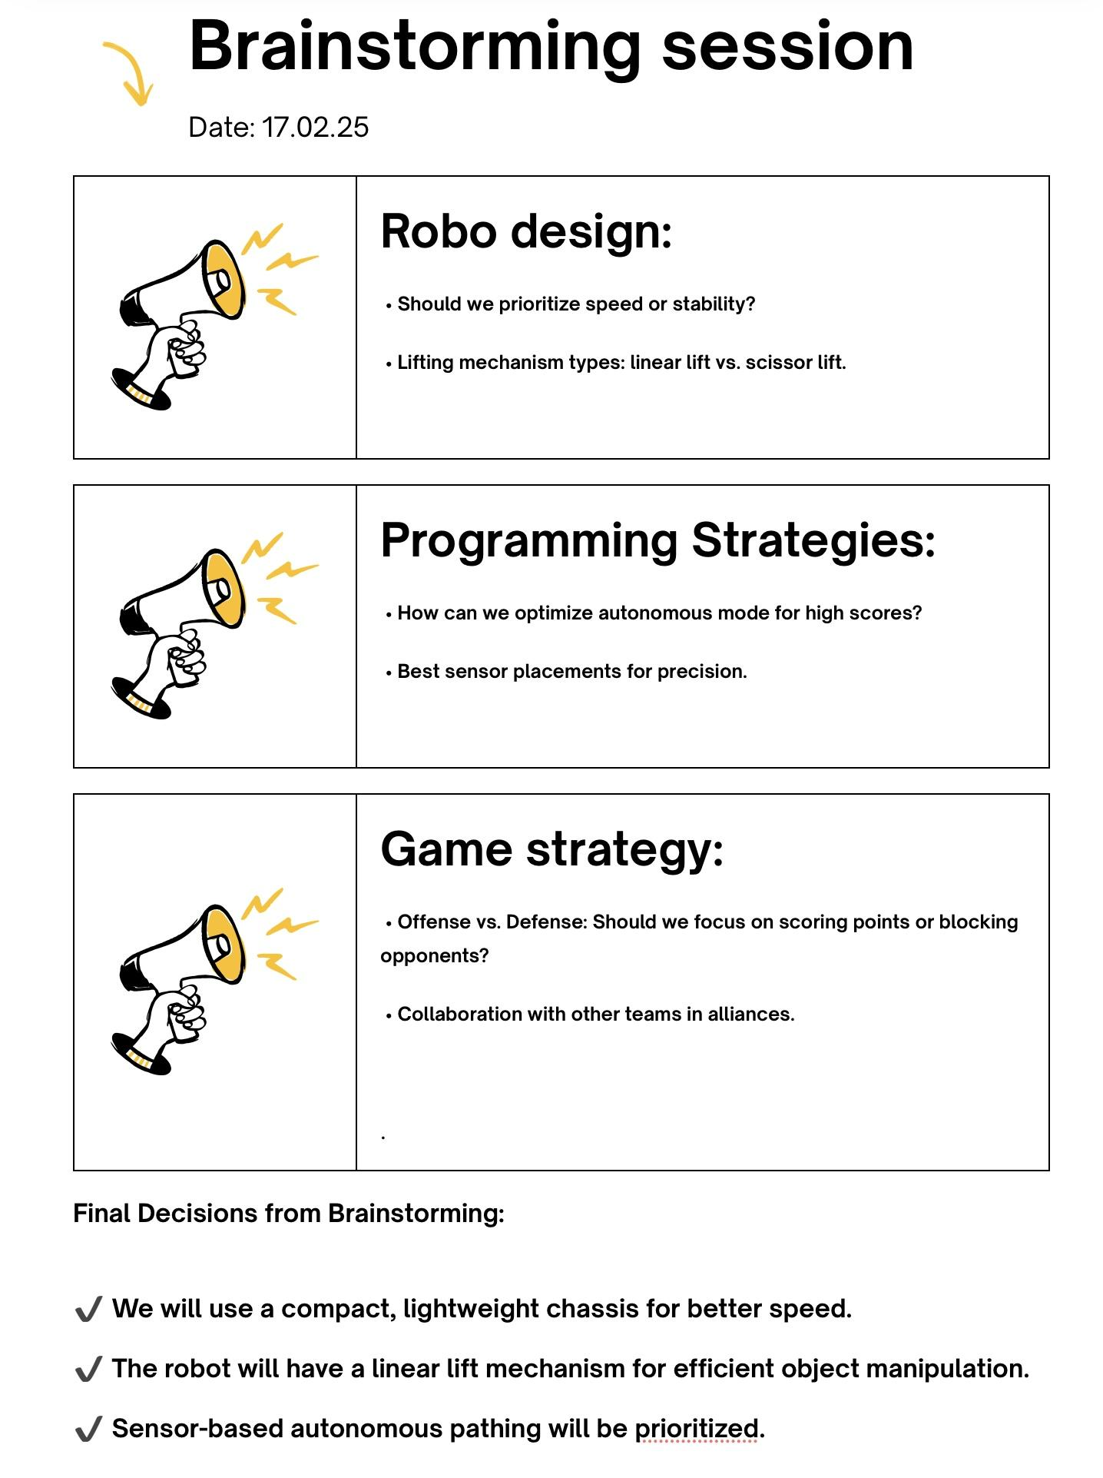

Slide 9
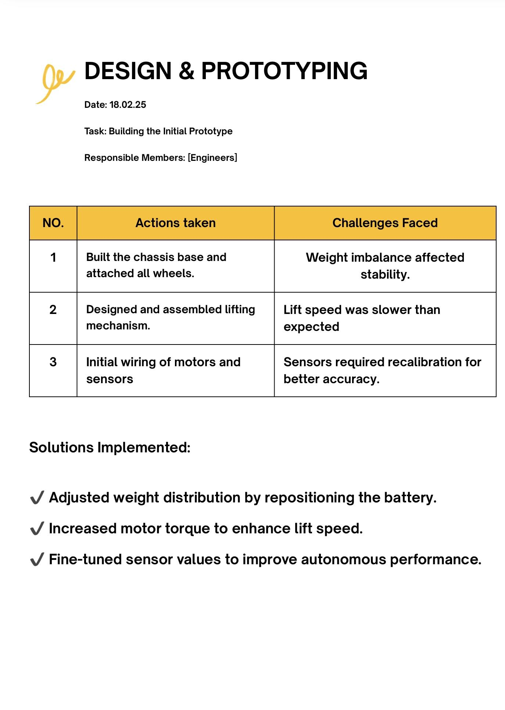

Slide 12
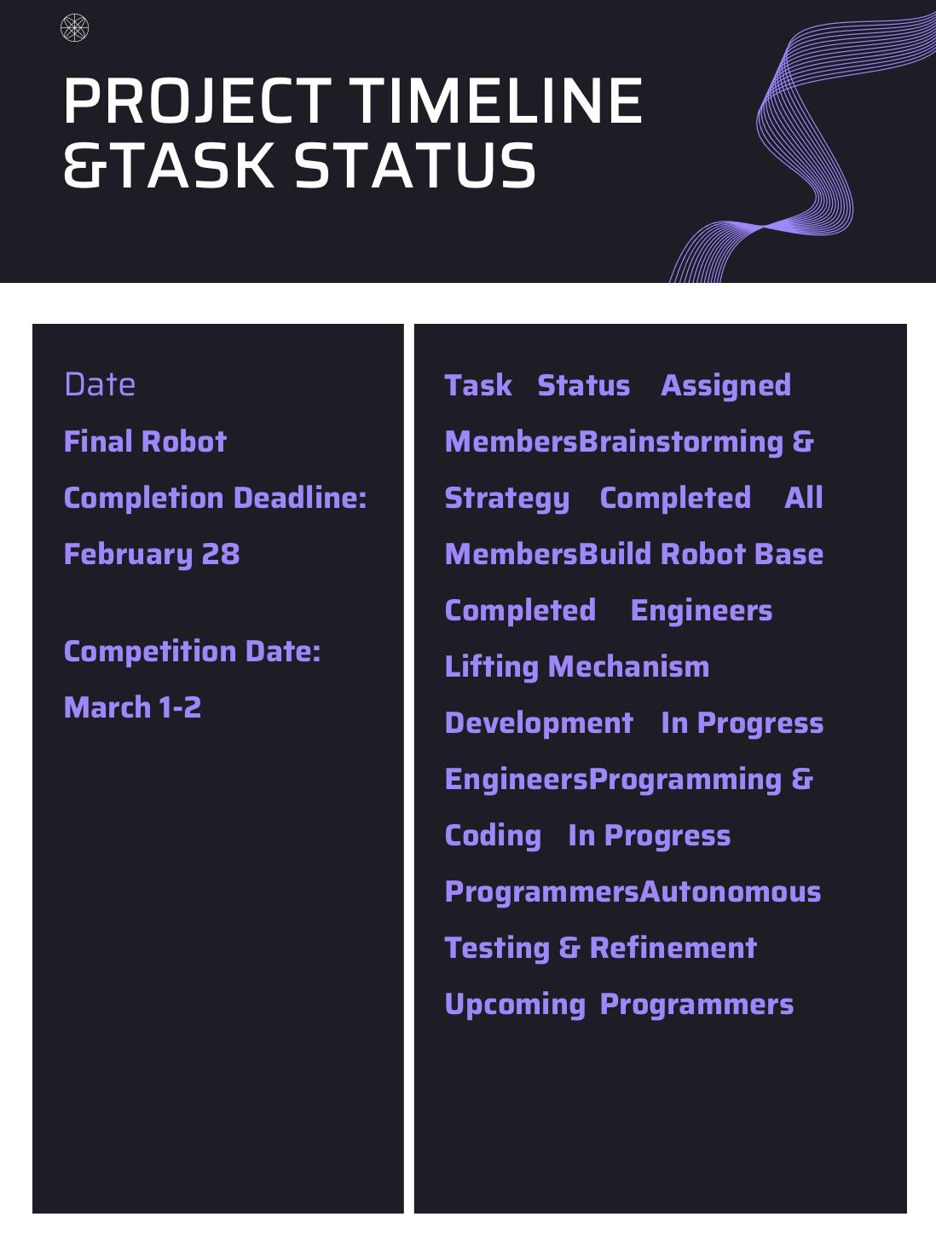

Slide 13
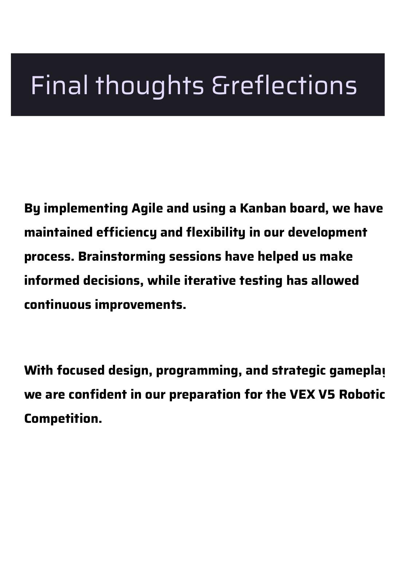

Slide 14
PORT
PORT
PORT
PORT
PORT
PORT
PORT
PORT
PORT
PORT
PORT
PORT
PORT
PORT
PORT
PORT
PORT
PORT
PORT
PORT
PORT
PORT
PORT
PORT
PORT
PORT
PORT
PORT
PORT

Slide 15
BUMPER
BUMPER
BUMPER
BUMPER
STICK
STICK
STICK
STICK
BUTTON
BUTTON
BUTTON
BUTTON
BUTTON
BUTTON
BUTTON
BUTTON

Slide 16
Blank High Stakes Field

Slide 17


“High Stakes” Starting Field with Moveable Game Objects

Slide 18
“High Stakes” Starting Field with Frozen Game Objects

Slide 19
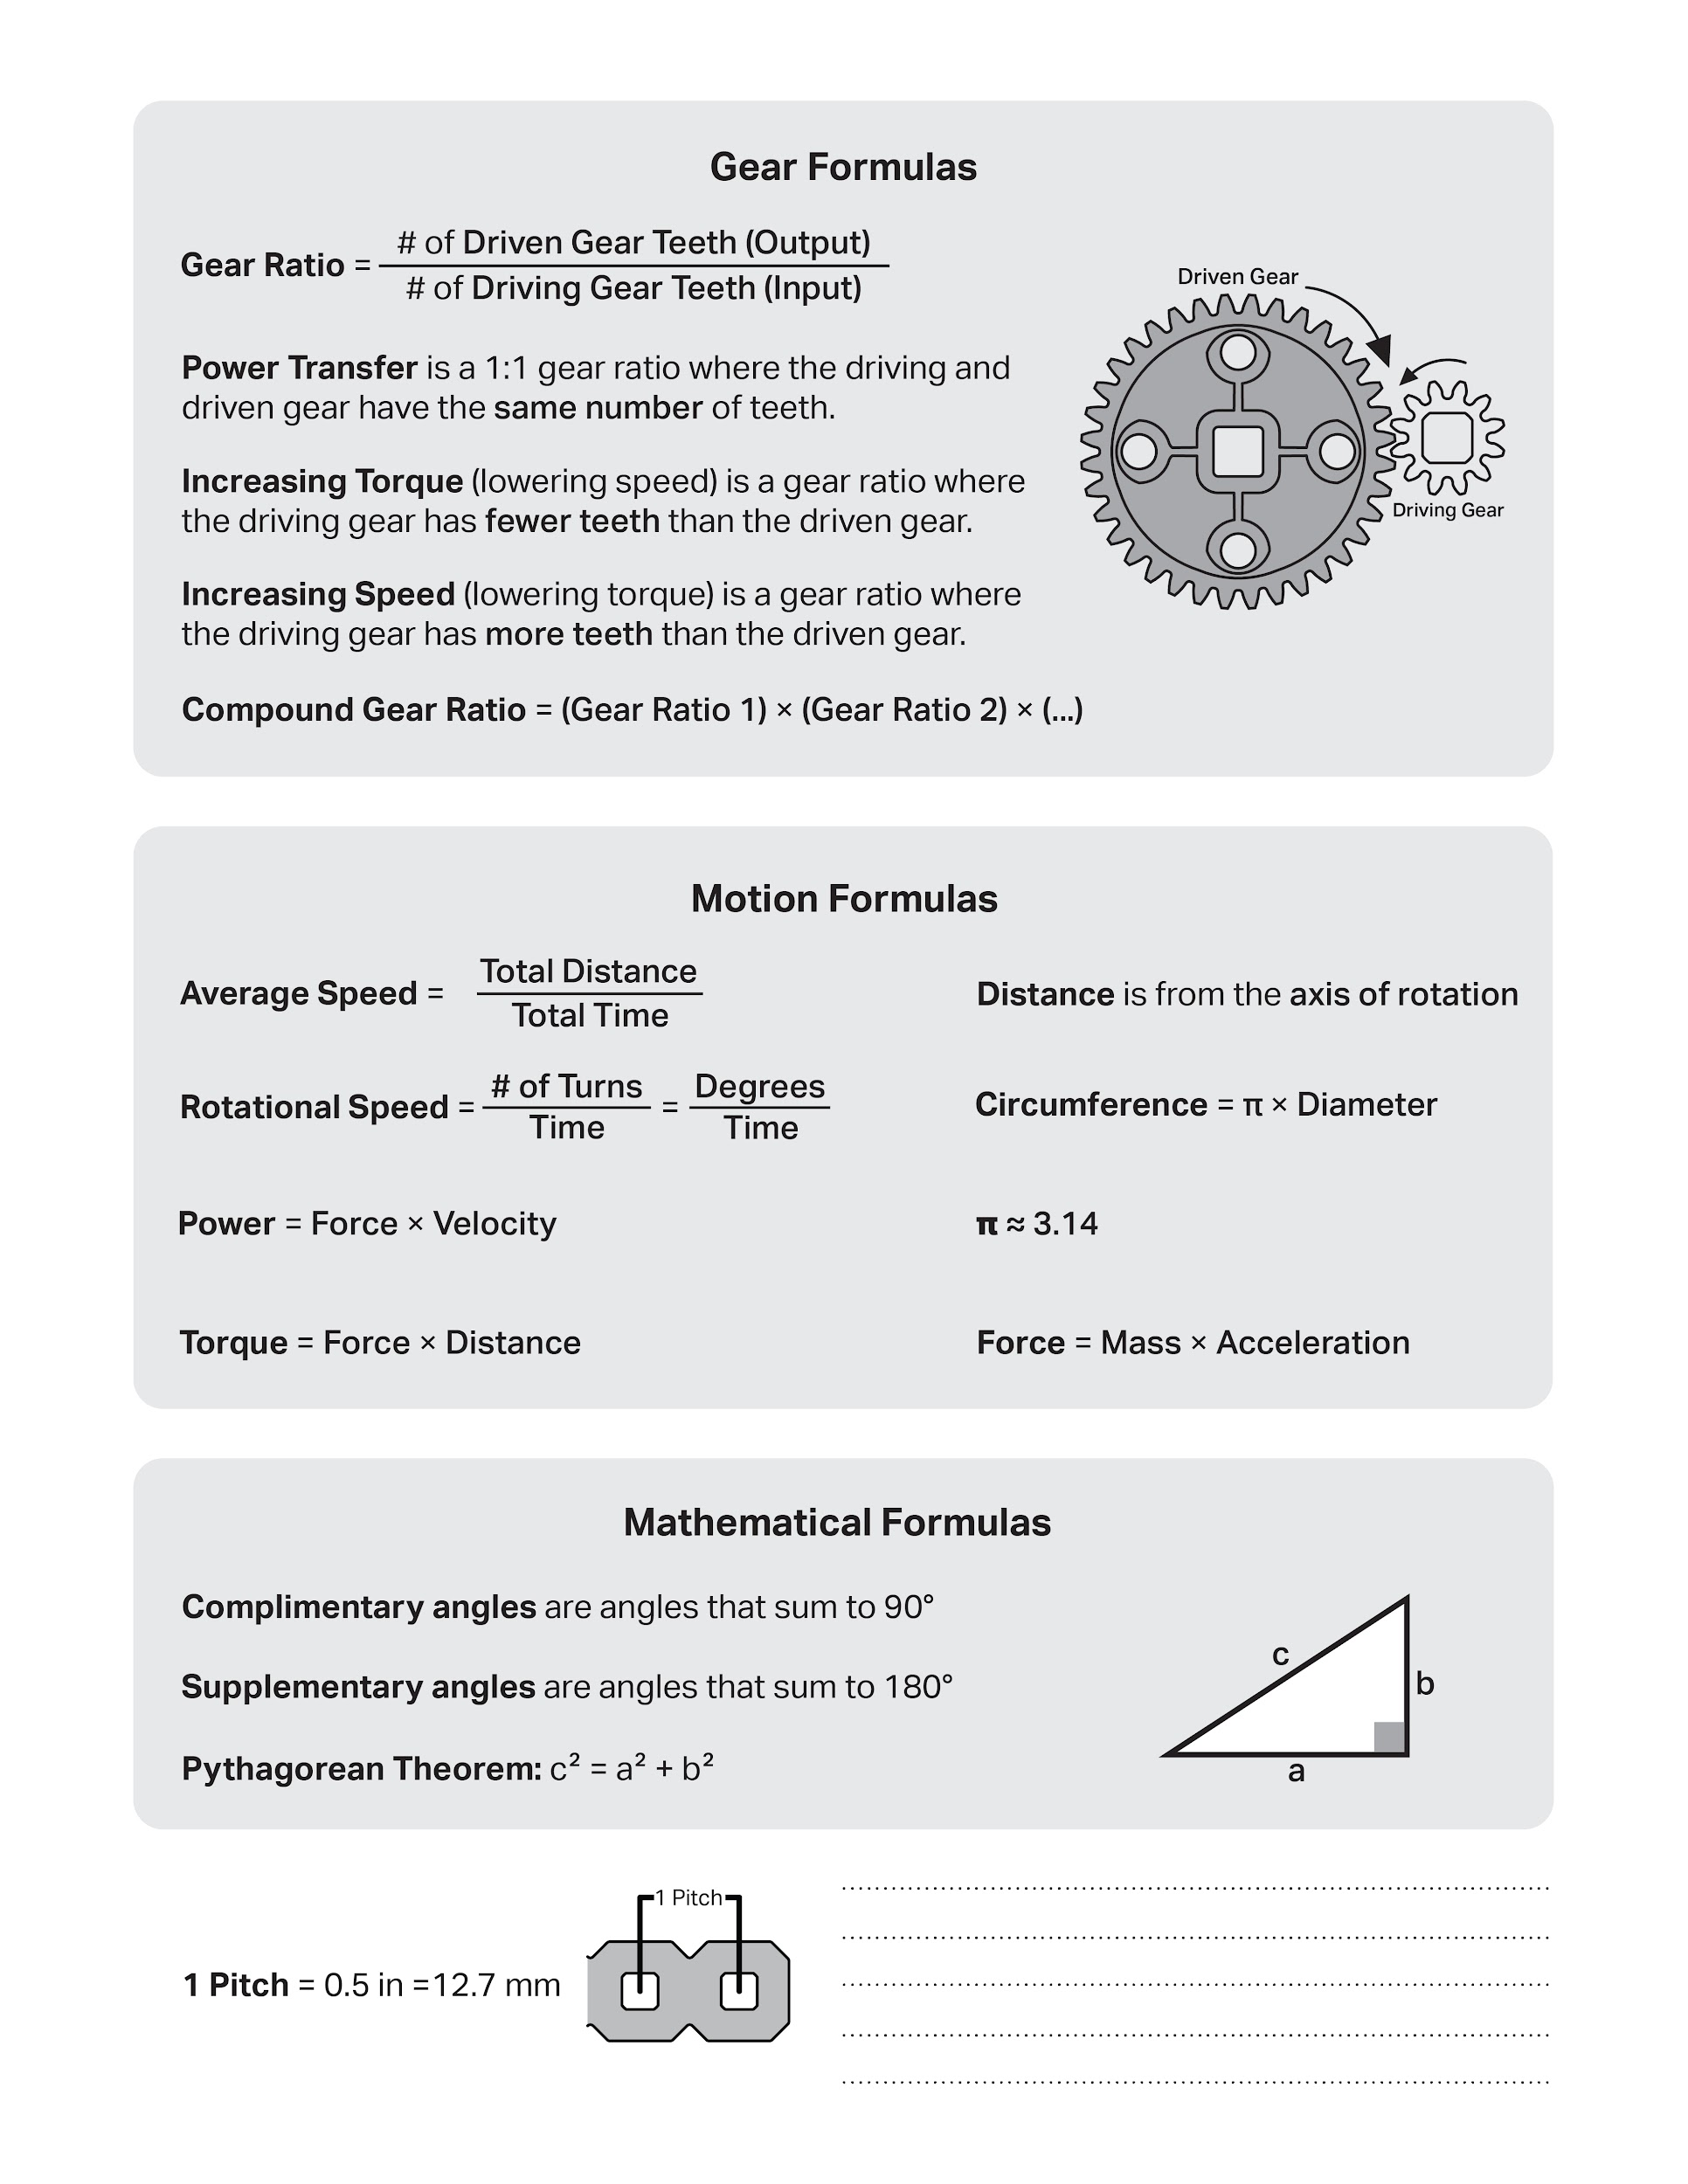

Slide 20
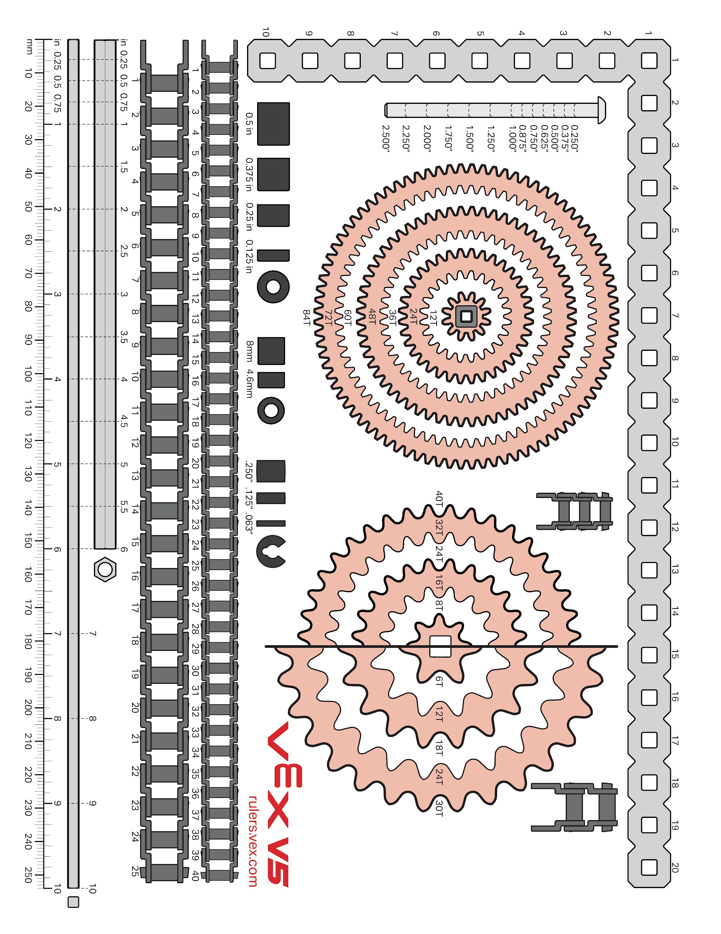

Slide 21
Week of: MM/DD/YYYY

